Slide 1
Chapter 11
Pricing Strategies

Slide 2
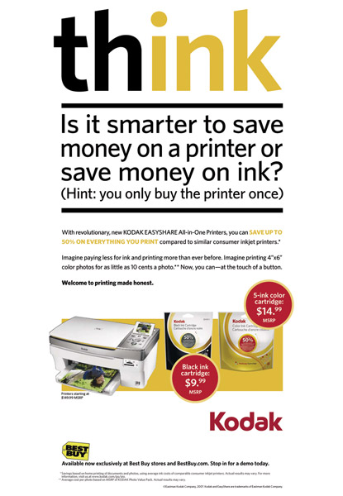
Pricing Strategies
Topic Outline
New-Product Pricing Strategies
Product Mix Pricing Strategies
Price Adjustment Strategies
Price Changes
Notes:
Check this

Slide 3
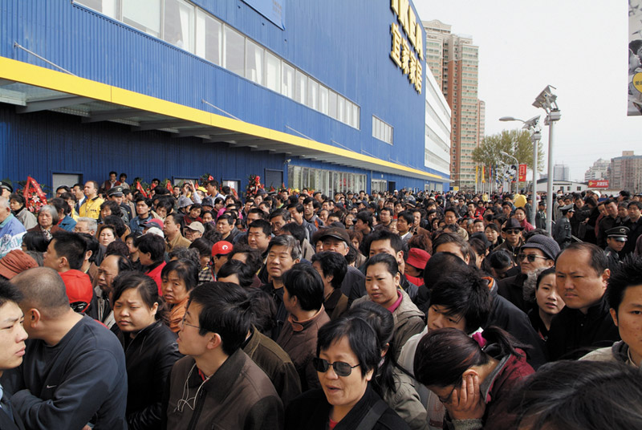
New-Product Pricing Strategies
Pricing Strategies
Market-skimming pricing
Market- penetration pricing

Slide 4
New-Product Pricing Strategies
Market-skimming pricing is a strategy with high initial prices to “skim” revenue layers from the market
Product quality and image must support the price
Buyers must want the product at the price
Costs of producing the product in small volume should not cancel the advantage of higher prices
Competitors should not be able to enter the market easily

Slide 5
New-Product Pricing Strategies
Pricing Strategies
Market-penetration pricing sets a low initial price in order to penetrate the market quickly and deeply to attract a large number of buyers quickly to gain market share
Price sensitive market
Inverse relationship of production and distribution cost to sales growth
Low prices must keep competition out of the market
Notes:
Note to Instructor
The text gives an excellent example of IKEA in China:
When IKEA first opened stores in China in 2002, people crowded to take advantage of the freebies—air conditioning, clean toilets, and even decorating ideas.
Chinese consumers are famously frugal. When it came time to actually buy, they shopped instead at local stores just down the street that offered knockoffs of IKEA’s designs at a fraction of the price.
So IKEA slashed its prices in China to the lowest in the world.
The penetration pricing strategy worked. IKEA now captures a 43 percent market share of China’s fast-growing home wares market.

Slide 6
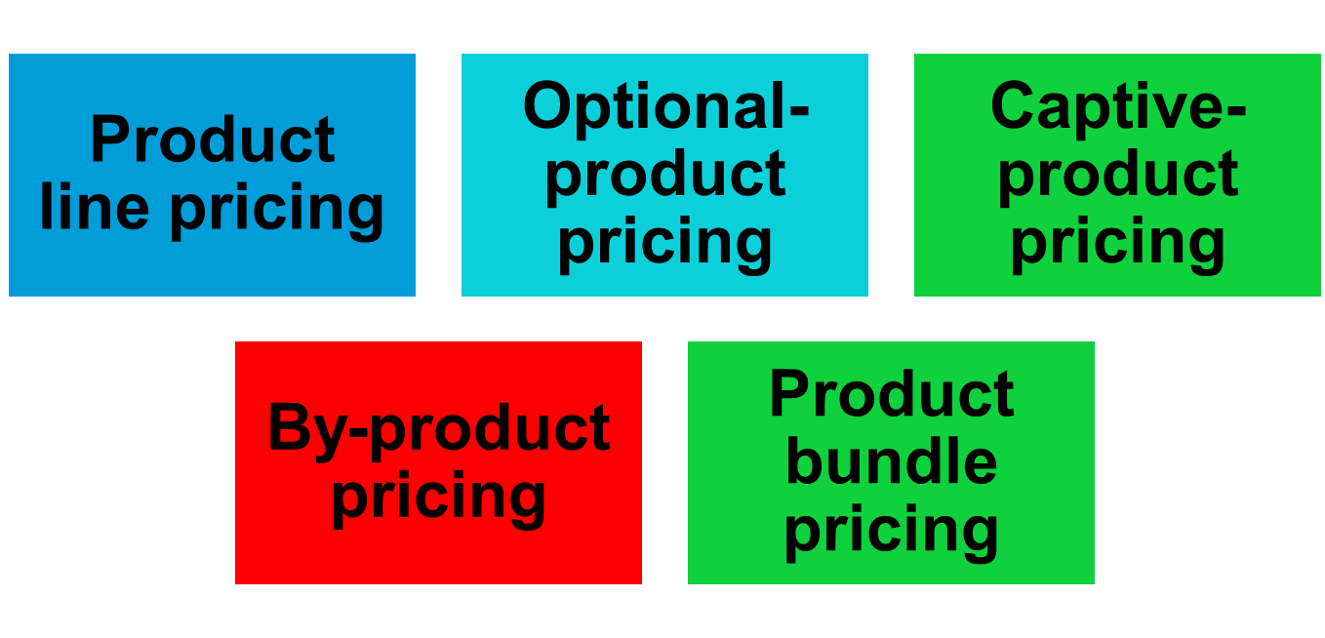
Product Mix Pricing Strategies
Pricing Strategies

Slide 7
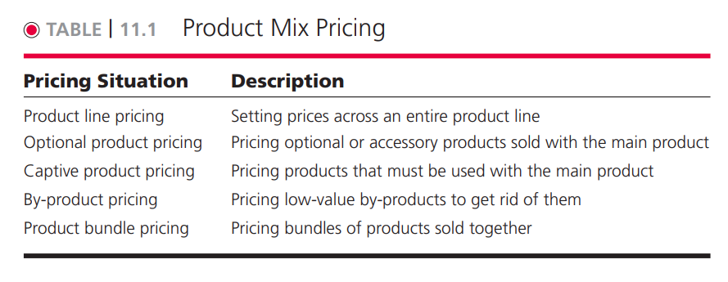

Slide 8

Product Mix Pricing Strategies
Pricing Strategies
Product line pricing takes into account the cost differences between products in the line, customer evaluation of their features, and competitors’ prices
Optional-product pricing takes into account optional or accessory products along with the main product

Slide 9

Product Mix Pricing Strategies
Pricing Strategies
Captive-product pricing involves products that must be used along with the main product.
By-product pricing refers to products with little or no value produced as a result of the main product. Producers will seek little or no profit other than the cost to cover storage and delivery.
Notes:
Note to Instructor
Students will quickly realize this is what their cell phone bill might be. Ask them how they feel about this pricing. This Web link goes to an ad for AT&T’s campaign for rollover minutes.
Note to Instructor
This Web link brings you to Bluemountain.com. Many students may know this site for its free greeting cards. Notice how they have product line pricing—you can get some basic cards for free but need to join to be able to use more advanced features.

Slide 10
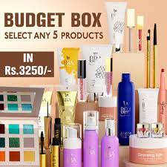
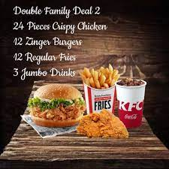
Product Mix Pricing Strategies
Pricing Strategies
Product bundle pricing combines several products at a reduced price.

Slide 11

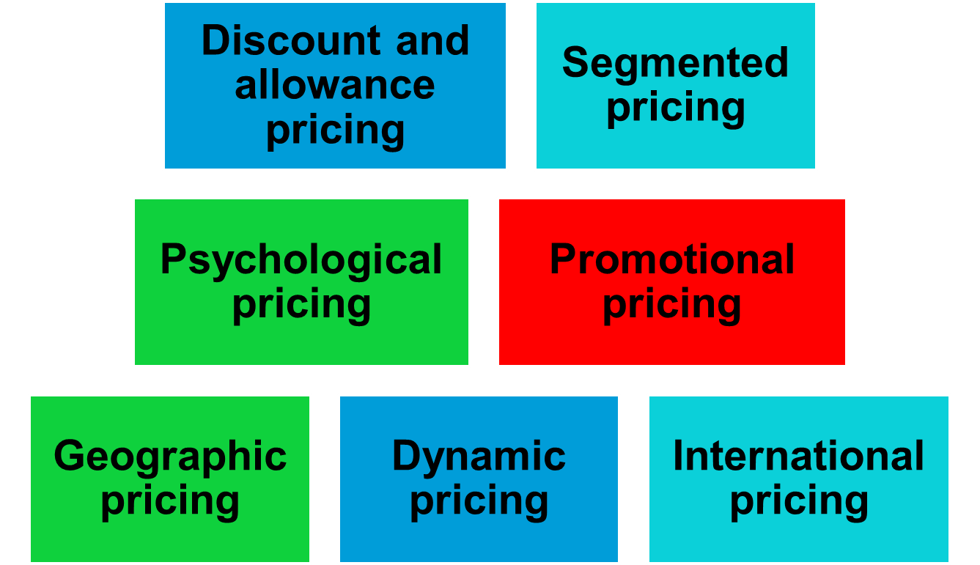
Price-Adjustment Strategies

Slide 12
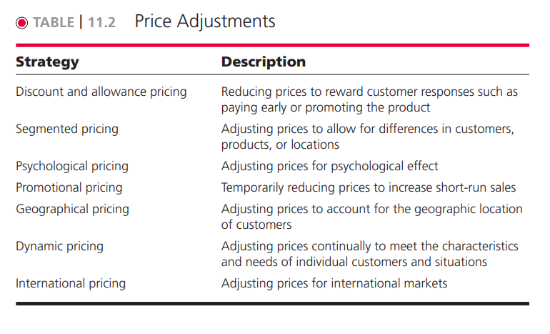
Price Adjustment Strategies

Slide 13
Price-Adjustment Strategies
Pricing Strategies
Discount and allowance pricing reduces prices to reward customer responses such as paying early or promoting the product
Discounts
Allowances
Notes:
Note to Instructor
Discounts are either cash discount for paying promptly, quantity discount for buying in large volume, or functional (trade) discount for selling, storing, distribution, and record keeping.
Allowances include trade-in allowance for turning in an old item when buying a new one and promotional allowance to reward dealers for participating in advertising or sales support programs.

Slide 14

Price-Adjustment Strategies
Pricing Strategies
Segmented pricing is used when a company sells a product at two or more prices even though the difference is not based on cost
Notes:
Note to Instructor
The three types of segmented pricing are:
Customer segment pricing is when different customers pay different prices for the same product or service.
Product form segment pricing is when different versions of the product are priced differently but not according to differences in cost.
Location pricing is when the product sold in different geographic areas is priced differently even though the cost is the same.

Slide 15
Price-Adjustment Strategies
Pricing Strategies
Segmented Pricing
To be effective:
Market must be segmentable
Segments must show different degrees of demand
Watching the market cannot exceed the extra revenue obtained from the price difference
Must be legal
Notes:
Note to Instructor
Discussion Question
How have you benefited from price segmentation?
Most likely they have had student discounts. Ask them why that is effective given the criteria above.

Slide 16
Price-Adjustment Strategies
Pricing Strategies
Psychological pricing occurs when sellers consider the psychology of prices and not simply the economics
Reference prices are prices that buyers carry in their minds and refer to when looking at a given product
  Noting current prices
  Remembering past prices
  Assessing the buying situations
Notes:
Note to Instructor
Discussion Question
How well do you carry prices of coffee, pizza, and milk in your head?
It might be interesting to collect the prices of items sold near or on campus including coffee, pizza, and sandwiches. Ask them how well they know these prices, have them write down the price of these items and then check themselves. You will often find that people do NOT know prices as well as they think they do.

Slide 17
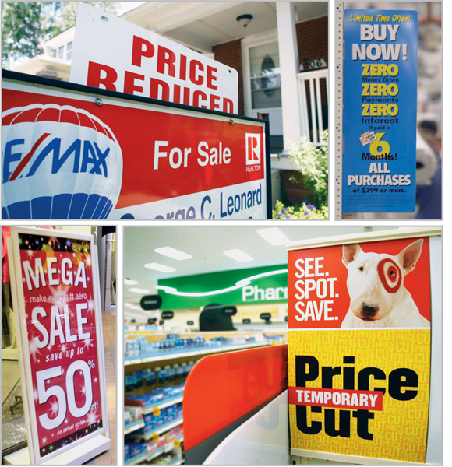
Price-Adjustment Strategies
Pricing Strategies
Promotional pricing is when prices are temporarily priced below list price or cost to increase demand
Loss leaders
Special event pricing
Cash rebates
Low-interest financing
Longer warrantees
Free maintenance
Notes:
Note to Instructor
Loss leaders are products sold below cost to attract customers in the hope they will buy other items at normal markups.
Special event pricing is used to attract customers during certain seasons or periods.
Cash rebates are given to consumers who buy products within a specified time.
Low-interest financing, longer warrantees, and free maintenance lower the consumer’s “total price.”

Slide 18
Price-Adjustment Strategies
Pricing Strategies
Risks of promotional pricing
Used too frequently, and copies by competitors can create “deal-prone” customers who will wait for promotions and avoid buying at regular price
Creates price wars

Slide 19
Price-Adjustment Strategies
Pricing Strategies
Geographical pricing is used for customers in different parts of the country or the world
FOB-origin pricing
Uniformed-delivered pricing
Zone pricing
Basing-point pricing
Freight-absorption pricing

Slide 20
Price-Adjustment Strategies
Pricing Strategies
FOB-origin (free on board) pricing means that the goods are delivered to the carrier and the title and responsibility passes to the customer
Uniformed-delivered pricing means the company charges the same price plus freight to all customers, regardless of location

Slide 21
Price-Adjustment Strategies
Pricing Strategies
Zone pricing means that the company sets up two or more zones where customers within a given zone pay a single total price
Basing-point pricing means that a seller selects a given city as a “basing point” and charges all customers the freight cost associated from that city to the customer location, regardless of the city from which the goods are actually shipped

Slide 22
Price-Adjustment Strategies
Pricing Strategies
Freight-absorption pricing means the seller absorbs all or part of the actual freight charge as an incentive to attract business in competitive markets

Slide 23

Price-Adjustment Strategies
Pricing Strategies
Dynamic pricing is when prices are adjusted continually to meet the characteristics and needs of the individual customer and situations
Notes:
Note to Instructor
There is an excellent example in the text for dynamic pricing:
Alaska airlines Web banner promotes “fly Alaska Airlines to Honolulu for $200 round trip.”
Alaska Airlines is introducing a system that creates unique prices and advertisements for people as they surf the Web. The system identifies consumers by their computers, using a small piece of code known as a cookie. It company then combines detailed data from several sources to paint a picture of who’s sitting on the other side of the screen.
When the person clicks on an ad, the system quickly analyzes the data to assess how price-sensitive customers seem to be.

Slide 24
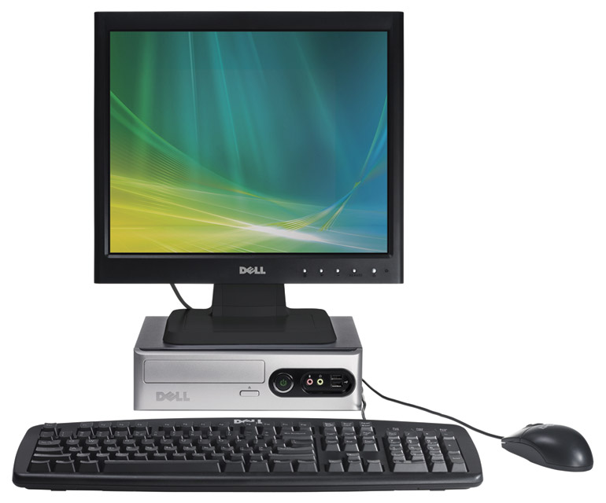
Price-Adjustment Strategies
Pricing Strategies
International pricing is when prices are set in a specific country based on country-specific factors
Economic conditions
Competitive conditions
Laws and regulations
Infrastructure
Company marketing
objective

Slide 25
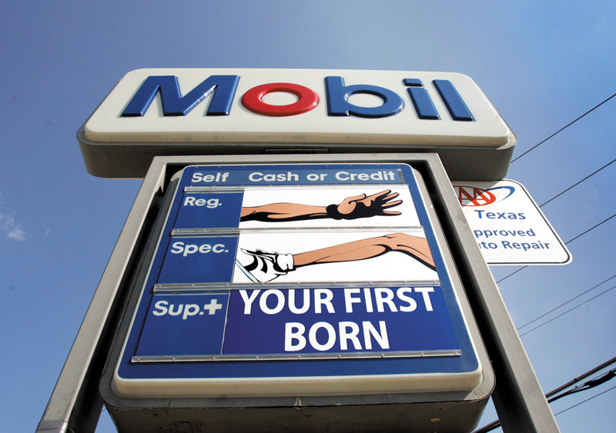
Price Changes
Initiating Pricing Changes
Price cuts
Price increases

Slide 26
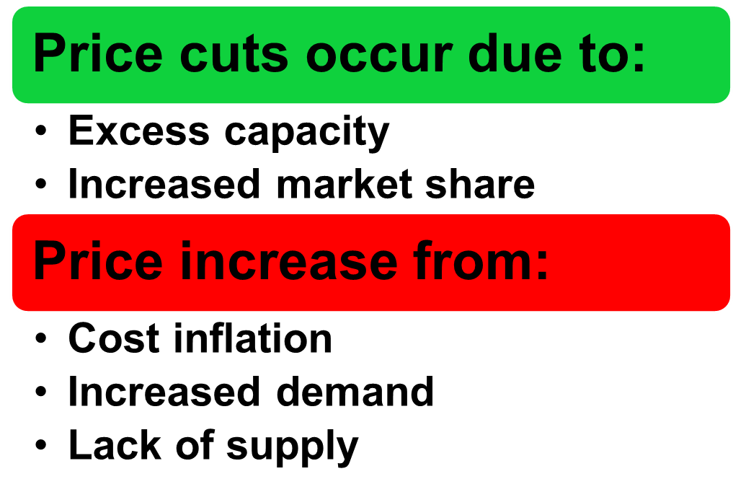
Price Changes
Initiating Pricing Changes (pp 354-357)

Slide 27
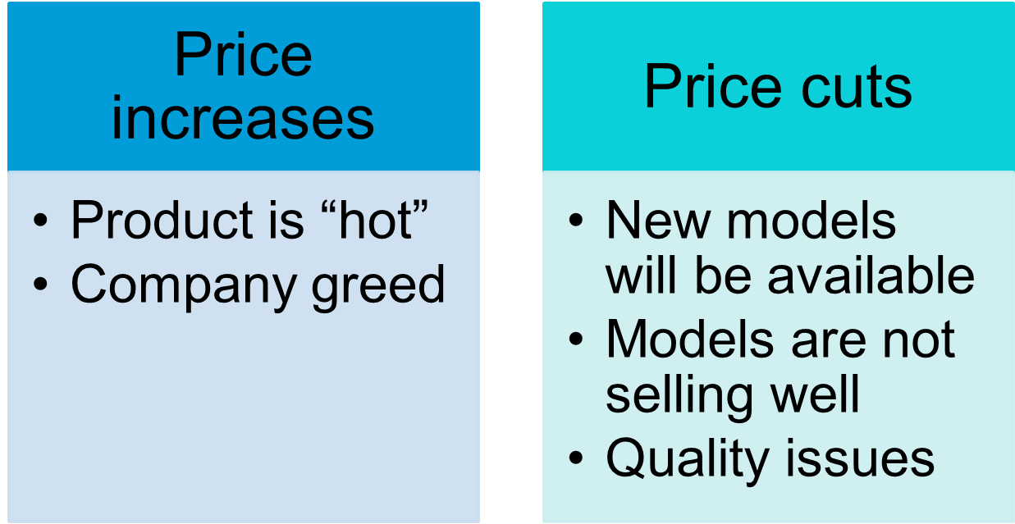
Price Changes
Buyer Reactions to Pricing Changes
Notes:
Note to Instructor
There is an example in the book about a Tiffany’s price changes:
In the late 1990s, the high-end jeweler responded to the “affordable luxuries” craze with a new “Return to Tiffany” line of less expensive silver jewelry.
The “Return to Tiffany” silver charm bracelet quickly became a must-have item, as teens jammed Tiffany’s hushed stores clamoring for the $110 silver bauble. Sales skyrocketed.
But despite this early success, Tiffany’s bosses grew worried that the bracelet fad could alienate the firm’s older, wealthier, and more conservative clientele.
So, in 2002, to chase away the teeny-boppers, the firm began hiking prices on the fast-growing, highly profitable line of cheaper silver jewelry and at the same time, it introduced pricier jewelry collections, renovated its stores, and showed off its craftsmanship by highlighting spectacular gems like a $2.5 million pink diamond ring.

Slide 28
Price Changes
Responding to Price Changes
Questions
  Why did the competitor change the price?
  Is the price cut permanent or temporary?
  What is the effect on market share and profits?
  Will competitors respond?

Slide 29
Price Changes
Responding to Price Changes
Solutions
  Reduce price to match competition
  Maintain price but raise the perceived value through communications
  Improve quality and increase price
  Launch a lower-price “fighting” brand

Slide 30
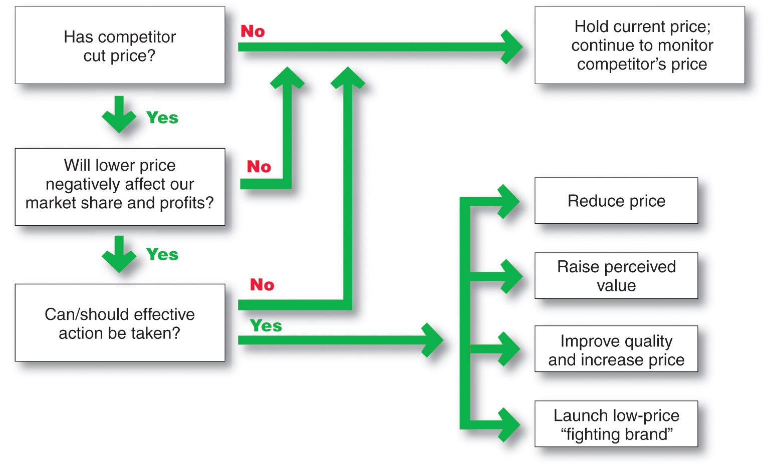
Price Changes
Responding to Price Changes

